Slide 1

Myotonic dystrophy
Introduction
Myotonic dystrophy is part of a group of inherited disorders called muscular dystrophies. It is the most common form of muscular dystrophy that begins in adulthood.
The muscular dystrophies are characterized by weakness and degeneration of various voluntary muscles of the body
There are two major types of myotonic dystrophy: type 1 and type 2. Their signs and symptoms overlap, although type 2 tends to be milder than type 1.

Slide 2
Myotonic dystrophy
Clinical manifestation /Symptoms
Myotonic dystrophy is characterized by progressive muscle wasting and weakness
Difficulty releasing their grip on a doorknob or handle
slurred speech or temporary locking of their jaw
The muscle weakness associated with type 1 particularly affects the lower legs, hands, neck, and face.
Muscle weakness in type 2 primarily involves the muscles of the neck, shoulders, elbows, and hips

Slide 3
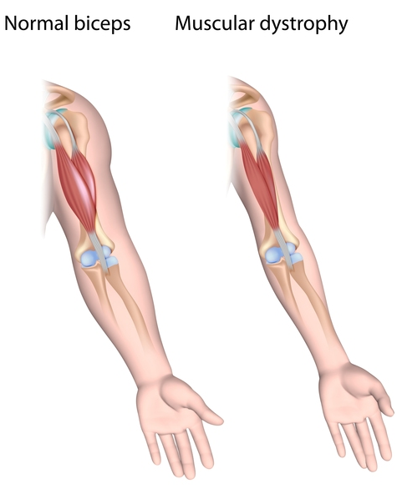
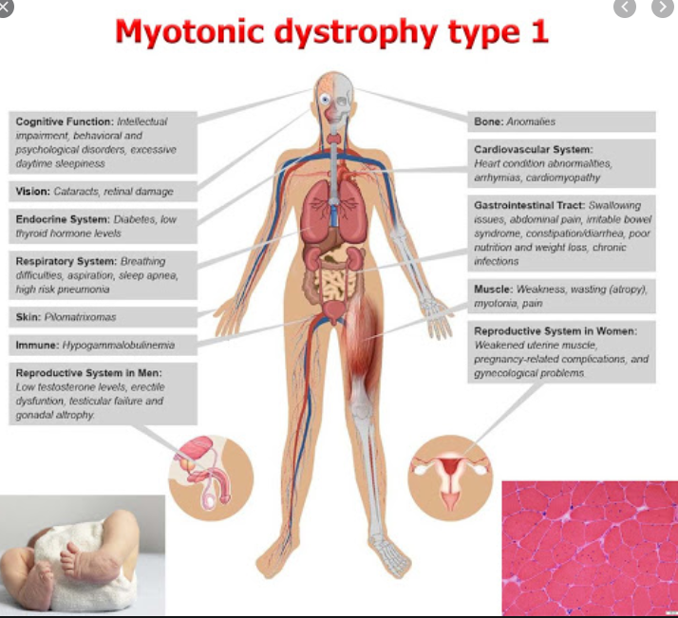
Myotonic dystrophy
Clinical manifestation /Symptoms

Slide 4
Myotonic dystrophy
Causes
The two types of myotonic dystrophy are caused by mutations in different genes.
Myotonic dystrophy type 1 is caused by mutations in the DMPK gene, while type 2 results from mutations in the CNBP gene.
The protein produced from the DMPK gene may play a role in communication within cells. It appears to be important for the correct functioning of cells in the heart, brain, and skeletal muscles (which are used for movement).
The protein produced from the CNBP gene is found primarily in the heart and in skeletal muscles, where it probably helps regulate the function of other genes.

Slide 5
Myotonic dystrophy
Inheritance Pattern
Both types of myotonic dystrophy are inherited in an autosomal dominant pattern

Slide 6
Myotonic dystrophy
Gene Panel
DMPK, CNBP
No of Genes :2
Sample Type : EDTA-blood sample - 4 ml
TAT : 6 Weeks
Methodology : NGS

Slide 7
Diagnostic Tests

Slide 9
Management

Slide 10
Myotonic dystrophy
Reference
https://rarediseases.info.nih.gov/diseases/6291/duchenne-muscular-dystrophy
https://ghr.nlm.nih.gov/gene/DMD
https://www.healthline.com/health/duchenne-muscular-dystrophy#treatment

